Slide 1
Personal Computer Applications
HNDIT1101
Lecture 07

Slide 2
Text Function
CLEAN, TRIM
CONCATENATE, LEFT, RIGHT, MID
LOWER, PROPER, UPPER
LEN, FIND, SEARCH, EXACT

Slide 3
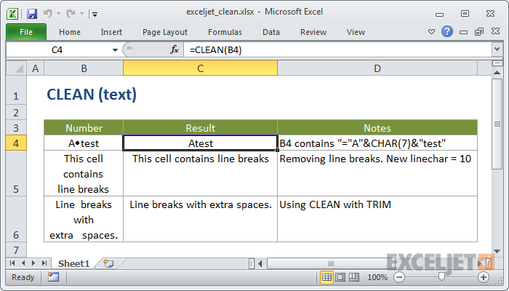
CLEAN, TRIM
Removes all nonprintable characters from text.

Slide 4
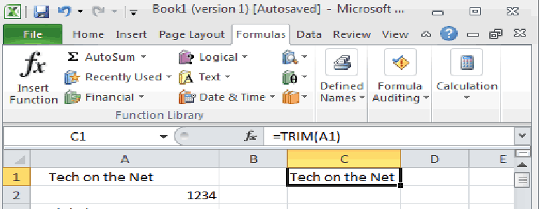
TRIM Function
Description
TRIM function returns a text value with the leading and trailing spaces removed.
The syntax :
=TRIM( text )

Slide 5
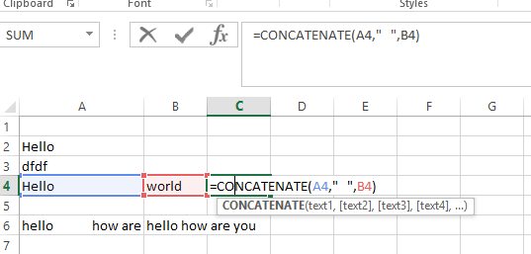
CONCATENATE function
Use CONCATENATE function to join two or more text strings into one string.
Syntax:
=CONCATENATE(text1, [text2], ...)

Slide 6
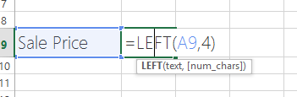
=LEFT(text, [num_chars])
Description
LEFT returns the first character or characters in a text string, based on the number of characters you specify.
Result :Sale

Slide 7
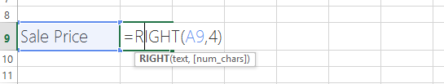
=RIGHT(text,[num_chars])
RIGHT returns the last character or characters in a text string, based on the number of characters you specify.
Note: rice

Slide 8

=MID(text, start_num, num_chars)
Description
MID returns a specific number of characters from a text string, starting at the position you specify, based on the number of characters you specify.
Result: ale

Slide 9


=LOWER()
Converts all uppercase letters in a text string to lowercase.
Syntax
=LOWER(text)
RESULT:

Slide 10


=PROPER(text)
Description
Capitalizes the first letter in a text string and any other letters in text that follow any character other than a letter. Converts all other letters to lowercase letters.
Syntax
=PROPER(text)
RESULT:

Slide 11

=UPPER(text)
Description
Converts text to uppercase.
Syntax
=UPPER(text)
Result: KUMARA

Slide 12

=LEN(text)
Description
LEN returns the number of characters in a text string.
Important LEN, counting 1 byte per character.
=LEN(text)
Return:5

Slide 13
=FIND(find_text, within_text, [start_num])
FIND locate one text string within a second text string, and return the number of the starting position of the first text string from the first character of the second text string.
Find_text Required. The text you want to find.
Within_text Required. The text containing the text you want to find.
Start_num Optional. Specifies the character at which to start the search. The first character in within_text is character number 1. If you omit start_num, it is assumed to be 1.

Slide 14
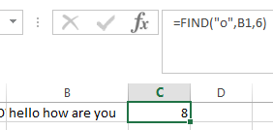
Position of the first “o" in cell B1, starting with the sixth character

Slide 15
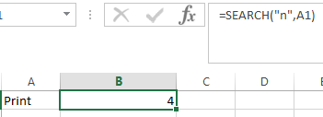
SEARCH()
The SEARCH functions locate one text string within a second text string, and return the number of the starting position of the first text string from the first character of the second text string.
For example, to find the position of the letter "n" in the word "printer", you can use the following function:
=SEARCH("n","printer") return 4
Syntax
=SEARCH(find_text,within_text,[start_num])

Slide 16
END

Slide 17
END

